Slide 1
DITA Linking

Slide 2
Session Results
DITA Linking – Learn the four ways to link
Hierarchical Links
Inline Links
Related Links (relationship (rel) tables)
Collection-type Links
Review the code examples of the ways to link
Review the output examples
Practice identifying types of links

Slide 3
DITA Linking – Four Ways to Link
Hierarchical Links (HTML) – When you organize your DITA map, you create parent, child, and sibling topics as you nest them and these relationships generate links.
Inline Links (all outputs) – Links in the text between topics that you create
Related Links (Relationship Tables) (HTML) – Links you create in a relationship table and these links appear at the end of topic automatically. Relationship tables are created in DITA map files.
Collection-type Links (HTML) – Links among a group of nested topics that are set in DITA maps.
Note: Determine the best way to use these types of links. Just because DITA supports them, doesn’t mean you should use them or that they fit your needs.

Slide 4
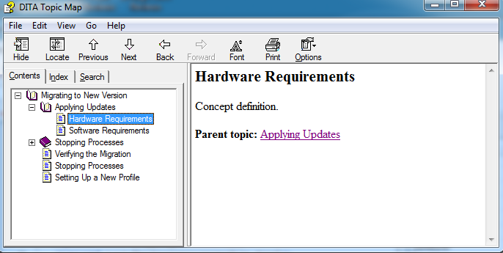
Hierarchical links (HTML)
By default, when you create a DITA in HTML outmap, you create parent, child, sibling topic relationships when you nest topics. These relationships give you linking put.
Sibling to Parent Relationship

Slide 5
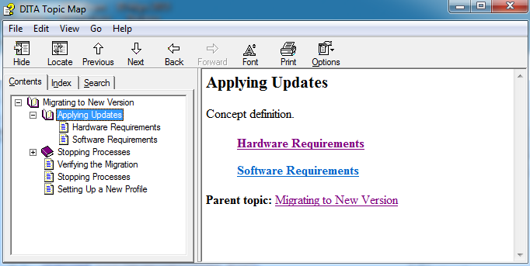
Hierarchical links (HTML)
Parent to Child Relationship

Slide 6
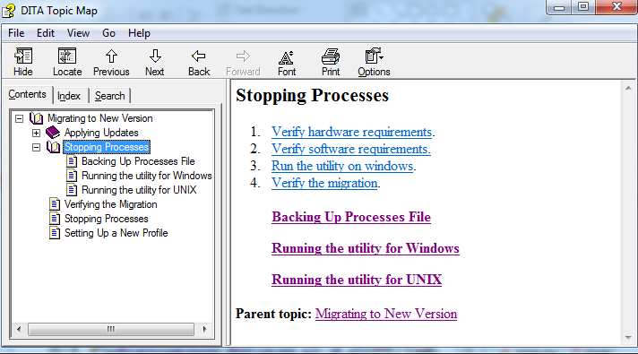
Inline links – all outputs
Inline links are those links that the writer adds manually using the xref attribute

Slide 7
Inline links – Be careful
Inline links can duplicate the HTML links so you must be knowledgeable of your output
What if you want both PDF and HTML output?
Can use conditions in the topic
Can create two topics – one for print and one for HTML
Industry Research on Inline Links
They are disruptive to content flow
Create dependencies between topics
Complicate navigation
Weight the content as important

Slide 8
Inline links – Best practices
Link to pre-requisite information and post-requisite information
Avoid inline links to tables and figures in a topic
Create inline links to repeated tasks (Repeat step 8) – DITA will renumber the xref automatically so you don’t need to worry about the numbering
Create inline links to high-level tasks – (However, you can accomplish the same thing in HTML with a collection-type or relationship table).

Slide 9
Control how inline links are displayed
Set the value for the linking attribute on the parent topic <topicref> element in the DITA map hierarchy or relationship table
Sourceonly – Topic can’t be linked to, but can link to other topics
Targetonly – Topic can only be linked to and can’t link to other topics
None – Topic cannot be linked to and cannot link to other topics
Normal – Topic can be linked to and can link to other topics (default)
Note: Caution against using these values because in a content-sharing world, they create inconsistent links in the output. Be judicious if you choose to use these values.

Slide 10
Relationship (rel) tables (HTML)
Relationship tables are created in a DITA map and they generate links on your HTML pages when the HTML output is generated
Rel Table Benefits
Centralized link management in the DITA map
Reduced maintenance because links are centralized
Improved reusability because of reduced file dependencies

Slide 11
Relationship tables – Options and best practices
Options
Topic-type link tables – Links are created by topic type and you are linking between topic types (concept, task, reference)
One-way link table – Links work one way from one topic to another
Two-way link table – Links work to and from topics
Custom tables – Customized links
Best Practices
Only one relationship table per DITA map
Create relationship tables in a DITA map that is separate from the topic hierarchy (allows for map reuse without rel tables)
Keep the number of related links between topics to less than 5

Slide 12
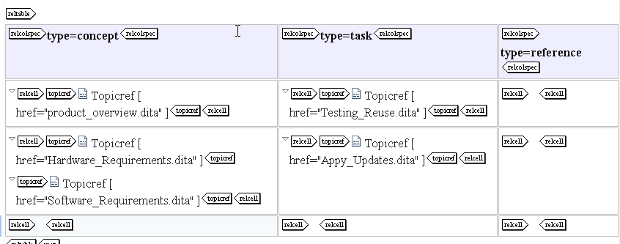
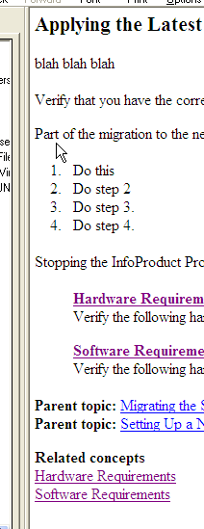
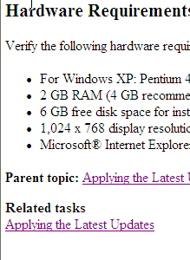
Topic-type relationship table - Example

Slide 13

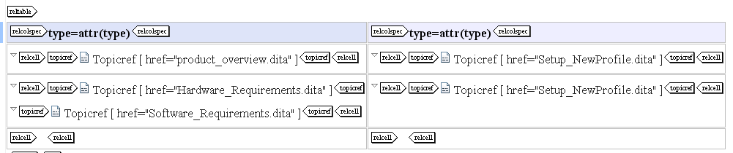
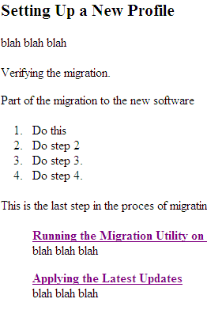
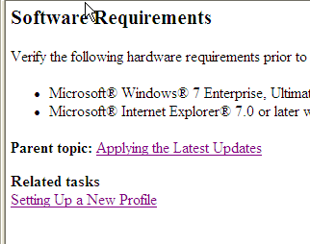
One-way link table
First column header uses linking=“sourceonly”
Second column header uses linking=“targetonly”
Related task link is in source only

Slide 14
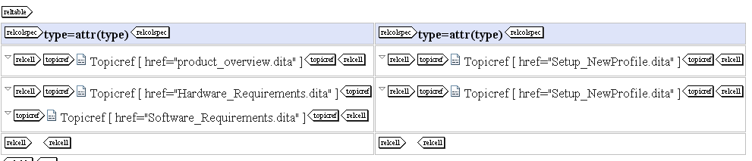

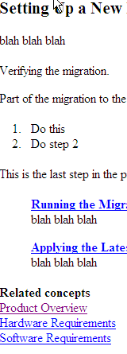
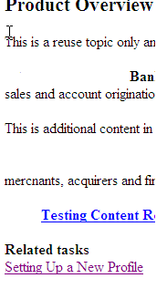
Two-way Linking Table
No attributes are set in the column headers

Slide 15
Collection-type links (HTML)
A collection type defines a relationship among nested topics and it also can specify the way links between parent, child, and sibling topics appear in HTML output
Guidelines
Collection-type should be set on parent topics
Collection-type only applies to one level of nested topics

Slide 16
Collection-type values
Set the value of the collection-type attribute on elements in a DITA map:
<topicref> in a DITA map
<topicgroup> elements in a relationship table
Columns in relationship tables
Valid Collection-type Values
Sequence – Creates numbered child topics with links to the next topic and the previous topic
Choice – Creates unordered child topics
Unordered – Creates unordered child topics
Family – Creates unordered child topics and related links between the child topics

Slide 17
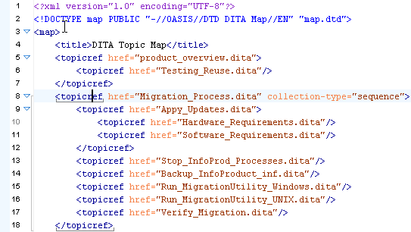
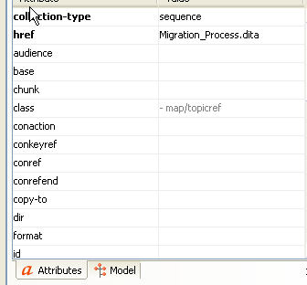
Sequence collection type

Slide 18
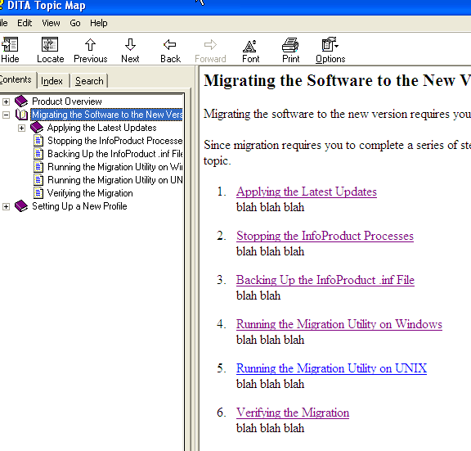
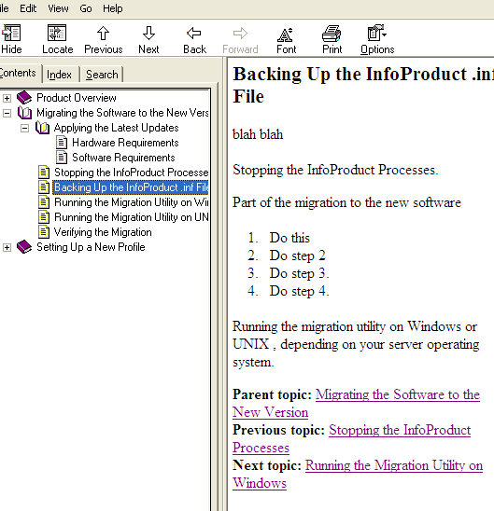
Sequence collection-type HTML output

Slide 19
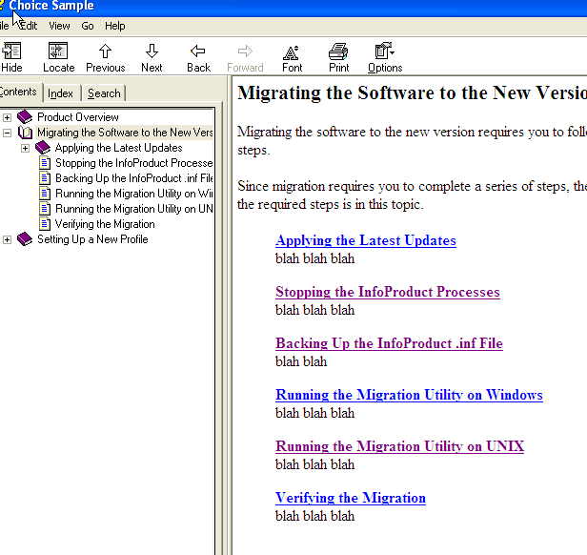
Choice selection-type HTML outputs
Child topics have no links added

Slide 20
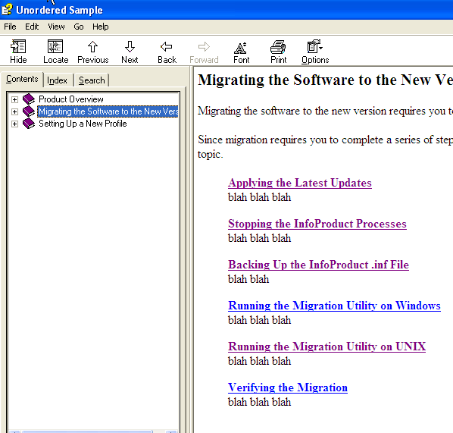
Unordered collection-type HTML output
The unordered and choice collection-type produce the same results; however, you must tag each correctly as the publication engine may be configured to style each differently

Slide 21
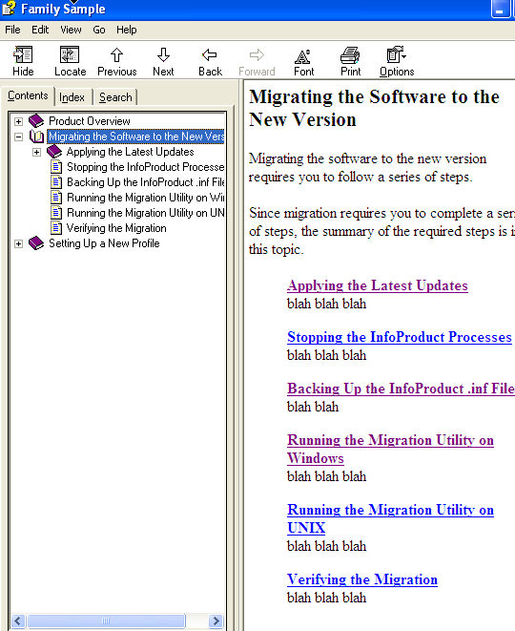
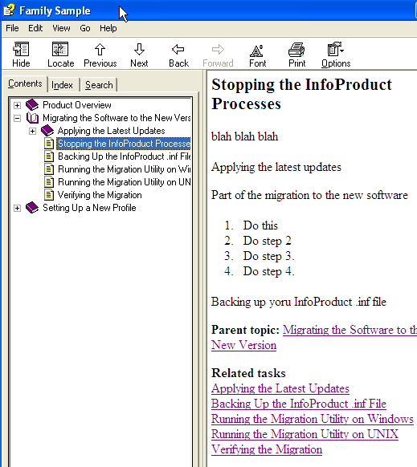
Family collection-type HTML output

Slide 22
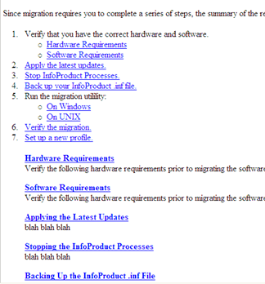
Pop quiz – Name the link type
Hierarchical
Inline
Relationship Table
Collection-type

Slide 23
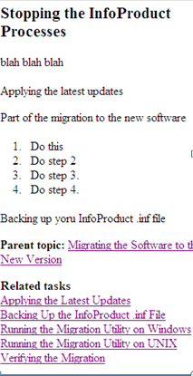
Name that link type
Hierarchical
Inline
Relationship Table
Collection-type

Slide 24
Think about
When working on projects:
Determine your linking based on the different forms of DITA linking and don’t create links that are not supported by DITA
Start planning linking strategy on your project deliverables and/or clean up the links that have been created

Slide 25
Session Results – Where we’ve been
DITA Linking – Learn the four ways to link
Hierarchical Links
Inline Links
Related Links (relationship (rel) tables)
Collection-type Links
Review the code examples of the ways to link
Review the output examples
Practice identifying types of links

